Slide 1
Graph Problems

Slide 2
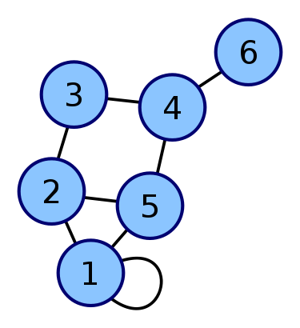
What is a Graph?
A set of nodes: V
A set of edges: E
G={V,E}

Slide 3
Graphs
Directed/Undirected
Weighted/Unweighted edges
Tree (or Forest)
DAG
Cycles

Slide 4
Representing a Graph
Adjacency Matrix
Adjacency List
Edge List

Slide 5
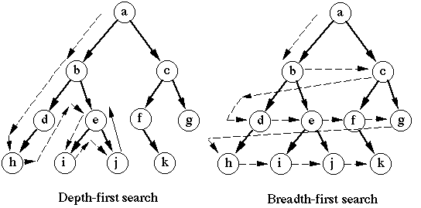
Traversing a graph
Depth first
Breadth first

Slide 6
Depth First Traversal
Dfs_main():
mark all nodes as Unvisited
for each node:
if node is not visited:
Dfs(node)
Dfs(node):
mark node as visited
process node
for each child c adjacent to node:
if c is not visited:
Dfs(c)

Slide 7
Applications of DFS
Connected Components
Testing for Cycles
Testing if the Graph is Bipartite
Strongly Connected Components
These are just a few examples, there are many other kinds of problems solvable with DFS.

Slide 8
Breadth First Traversal
Bfs(start_node):
mark all nodes as unseen
mark start_node as seen
insert start_node into Queue
while Queue is not empty:
get node from Queue
process node
for child c adjacent to node:
if c is not seen:
mark c as seen
insert c into Queue

Slide 9
Applications of BFS
Basically any problem that needs shortest path/sequence of steps to reach solution
Most problems that can be solved by DFS also just as easily work with BFS.

Slide 10
Dijkstra’s Algorithm
void dijkstra(node start) {
priorityQueue s;
s.add(start);
while (s.empty() == false) {
top = s.top(); s.pop();
mark top as visited;
check for termination condition
(have we reached the target node?) add all of top's unvisited neighbors to the stack.
}
}
(taken from TopCoder tutorials)

Slide 11
All Pairs Shortest Paths: Floyd Warshall
for (int k=0;k<N;k++){
for(int i=0;i<N;i++){
for(int j=0;j<N;j++){
cost[i][j]=min(cost[i][j],cost[i][k]+cost[k][j]);
}
}
}

Slide 12
Spanning Trees
A tree formed by taking only enough edges to connect all nodes in a graph.
A spanning tree where the total cost of all the edges is minimized is called a Minimum Spanning Tree

Slide 13
Prim’s Algorithm
Prim():
push node 0 to PriorityQueue with cost 0
while PriorityQueue is not empty:
pop node from Queue
if node is already added continue
mark node as added
add cost of node to total cost
for each child c adjacent to node:
push c into PriorityQueue with cost=cost[node][c]
return total cost

Slide 14
Kruskal’s Algorithm
Kruskal(edge_list):
sort(edge_list)
tree={}
for each edge (u,v) in edge_list:
if u and v are not already connected
add (u,v) to tree
return tree

Slide 15
Kruskal’s Algorithm
Kruskal(edge_list):
total_cost=0
for each node:
parent[node]=node
sort(edge_list)
for each edge (u,v) in edge_list:
if (root(u)!=root(v)):
parent[u]=root(v)
total_cost+=cost of (u,v)
return total_cost

Slide 16
Kruskal (Continued)
Root(node):
while parent[node]!=node:
node=parent[node]
return node

